Slide 1



Slide 2
Noble Prizes (1910 – 1919)
Team Members:
Laiba Khan ( se-211066 )
Zeeshan Javed ( se-211067 )
M Rehan ( SE-211078 )
M Hanzalah ( se-211090 )
Huzaifa Khalid ( se-211102 )

Slide 3
Noble Prizes (1910) [NAME OF THE PRIZE WINNER]
Bureau international permanent de la Paix (Permanent International Peace Bureau) “for acting as a link between the peace societies of the various countries, and helping them to organize the world rallies of the international peace movement”
Paul Johann Ludwig Heyse “as a tribute to the consummate artistry, permeated with idealism, which he has demonstrated during his long productive career as a lyric poet, dramatist, novelist and writer of world-renowned short stories”
Albrecht Kossel “in recognition of the contributions to our knowledge of cell chemistry made through his work on proteins, including the nucleic substances”

Slide 4
Noble Prizes (1910) [NAME OF THE PRIZE WINNER]
Otto Wallach “in recognition of his services to organic chemistry and the chemical industry by his pioneer work in the field of alicyclic compounds”
Johannes Diderik van der Waals “for his work on the equation of state for gases and liquids”

Slide 5
Noble Prizes (1911) [NAME OF THE PRIZE WINNER]
Alfred Hermann Fried “for his effort to expose and fight what he considers to be the main cause of war, namely, the anarchy in international relations”
Tobias Michael Carel Asser “for his role as co-founder of the Institute de droit international, initiator of the Conferences on International Private Law (Conferences de Droit international privé) at the Hague, and pioneer in the field of international legal relations”
Allvar Gullstrand “for his work on the dioptrics of the eye”

Slide 6
Noble Prizes (1911) [NAME OF THE PRIZE WINNER]
Count Maurice (Mooris) Polidore Marie Bernhard Maeterlinck “in appreciation of his many-sided literary activities, and especially of his dramatic works, which are distinguished by a wealth of imagination and by a poetic fancy, which reveals, sometimes in the guise of a fairy tale, a deep inspiration, while in a mysterious way they appeal to the readers’ own feelings and stimulate their imaginations”
Marie Curie, née Sklodowska “in recognition of her services to the advancement of chemistry by the discovery of the elements radium and polonium, by the isolation of radium and the study of the nature and compounds of this remarkable element”
Wilhelm Wien “for his discoveries regarding the laws governing the radiation of heat”

Slide 7
Noble Prizes (1912) [NAME OF THE PRIZE WINNER]
Elihu Root “for bringing about better understanding between the countries of North and South America and initiating important arbitration agreements between the United States and other countries”
Gerhart Johann Robert Hauptmann “primarily in recognition of his fruitful, varied and outstanding production in the realm of dramatic art”
Alexis Carrel “in recognition of his work on vascular suture and the transplantation of blood vessels and organs”

Slide 8
Noble Prizes (1912) [NAME OF THE PRIZE WINNER]
Paul Sabatier “for his method of hydrogenating organic compounds in the presence of finely disintegrated metals whereby the progress of organic chemistry has been greatly advanced in recent years”
Victor Grignard “for the discovery of the so-called Grignard reagent, which in recent years has greatly advanced the progress of organic chemistry”
Nils Gustaf Dalén “for his invention of automatic regulators for use in conjunction with gas accumulators for illuminating lighthouses and buoys”

Slide 9
Noble Prizes (1913) [NAME OF THE PRIZE WINNER]
Henri La Fontaine “for his unparalleled contribution to the organization of peaceful internationalism”
Rabindranath Tagore “because of his profoundly sensitive, fresh and beautiful verse, by which, with consummate skill, he has made his poetic thought, expressed in his own English words, a part of the literature of the West”
Charles Robert Richet “in recognition of his work on anaphylaxis”

Slide 10
Noble Prizes (1913) [NAME OF THE PRIZE WINNER]
Alfred Werner “in recognition of his work on the linkage of atoms in molecules by which he has thrown new light on earlier investigations and opened up new fields of research especially in inorganic chemistry”
Heike Kamerlingh Onnes “for his investigations on the properties of matter at low temperatures which led, inter alia, to the production of liquid helium”

Slide 11
Noble Prizes (1914) [NAME OF THE PRIZE WINNER]
Robert Bárány “for his work on the physiology and pathology of the vestibular apparatus”
Theodore William Richards “in recognition of his accurate determinations of the atomic weight of a large number of chemical elements”
Max von Laue “for his discovery of the diffraction of X-rays by crystals”

Slide 12
Noble Prizes (1915 - 1916) [NAME OF THE PRIZE WINNER]
Romain Rolland “as a tribute to the lofty idealism of his literary production and to the sympathy and love of truth with which he has described different types of human beings”
Richard Martin Willstätter “for his researches on plant pigments, especially chlorophyll”
Sir William Henry Bragg & William Lawrence Bragg “for their services in the analysis of crystal structure by means of X-rays”
Carl Gustaf Verner von Heidenstam “in recognition of his significance as the leading representative of a new era in our literature”

Slide 13
Noble Prizes (1917) [NAME OF THE PRIZE WINNER]
Comité international de la Croix Rouge (International Committee of the Red Cross) “for the efforts to take care of wounded soldiers and prisoners of war and their families”
Karl Adolph Gjellerup “for his varied and rich poetry, which is inspired by lofty ideals”
Henrik Pontoppidan “for his authentic descriptions of present-day life in Denmark”
Charles Glover Barkla “for his discovery of the characteristic Röntgen radiation of the elements”

Slide 14
Noble Prizes (1918) [NAME OF THE PRIZE WINNER]
Fritz Haber “for the synthesis of ammonia from its elements”
Max Karl Ernst Ludwig Planck “in recognition of the services he rendered to the advancement of Physics by his discovery of energy quanta”

Slide 15
Noble Prizes (1919) [NAME OF THE PRIZE WINNER]
Thomas Woodrow Wilson “for his role as founder of the League of Nations”
Carl Friedrich Georg Spitteler “in special appreciation of his epic, Olympian Spring”
Jules Bordet “for his discoveries relating to immunity”
Johannes Stark “for his discovery of the Doppler effect in canal rays and the splitting of spectral lines in electric fields”

Slide 16
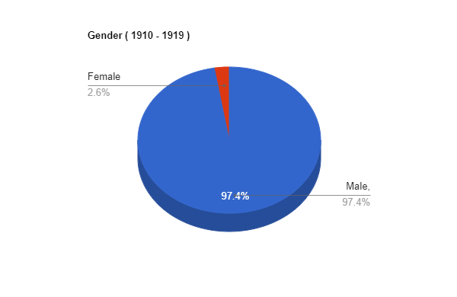
Noble Prizes (1910 – 1919) [Gender (M/F)]
Male = 37 M ; Female = 01 F

Slide 17
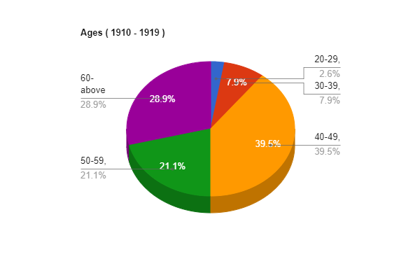
Noble Prizes (1910 – 1919) [Ages]
20 – 29 = 01 person
30 – 39 = 03 persons
40 – 49 = 15 persons
50 – 59 = 08 persons
60 – above = 11 persons

Slide 18
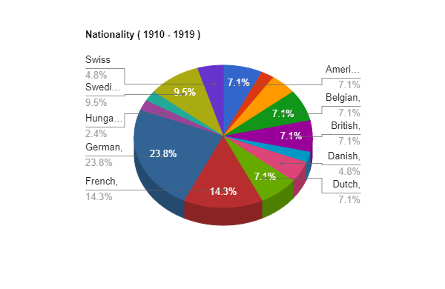
Noble Prizes (1910 – 1919) [Nationality]
American = 3 persons
Australian = 1 person
Austrian = 2 persons
Belgian = 3 persons
Bengali = 1 person
British = 3 persons
Danish = 2 persons
Dutch = 3 persons
French = 6 persons
German = 10 persons
Hungarian = 1 person
Indian = 1 person
Swedish = 4 persons
Swiss = 2 persons

Slide 19
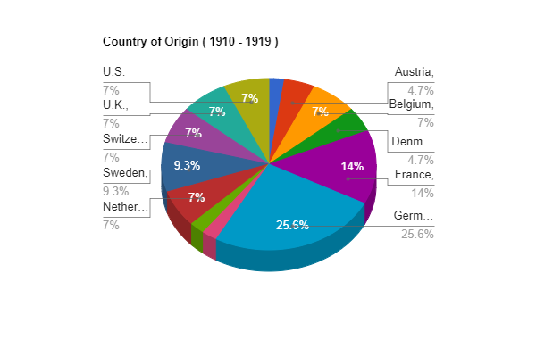
Noble Prizes (1910 – 1919) [Country of Origin]
Australia = 1 person
Austria = 2 persons
Belgium = 3 persons
Denmark = 2 persons
France = 6 persons
Germany = 10 persons + 1 institute
Hungary = 1 person
India = 1 person
Netherlands = 3 persons
Sweden = 4 persons
Switzerland = 2 persons + 1 institute
United Kingdom = 3 persons
United States = 3 persons

Slide 20
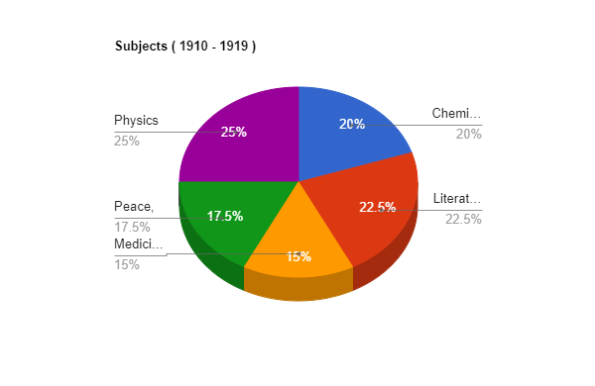
Noble Prizes (1910 – 1919) [Subjects]
Chemistry = 8 persons
Literature = 9 persons
Medicine = 6 persons
Peace = 5 persons + 2 institutes
Physics = 10 persons

Slide 21


